Slide 1
Version Control with Git
Basics of git, integrating git with GitHub and equivalent platforms

Slide 2
Introduction
In this course, will cover the basic functions of Git and how it can be integrated with GitHub (or equivalent platforms).
You’ll practice using Git commands in the terminal to add version control to your project, allowing you to switch between different versions of your progress and branch off to create new features.

Slide 3
Introduction
By the end of this course, you’ll be able to:
Create a Git project and setup a remote copy on GitHub.
Label changes and move between different versions of your project.
Create branches in your Git project so you can collaborate with others.
Use Git commands to make sure your local copy of code matches the remote copy on GitHub.
Be familiar with Git rebase, GitHub repository settings, and how to keep a remote repository organized.
How to create a GitHub profile and explore code written by others

Slide 4
01
Presentation of Git

Slide 5
Version Control Systems (VCS)
Git is one of the most popular version control systems (VCS).
A version control (or revision or source control) system is any system that manages multiple versions of files(e.g. source code, reports, videos, etc)
Version control is essential for team projects and also very useful for individual projects.
There are 2 main types of VCS; centralized and distributed.
Some other version control systems are CVS, Subversion and Mercurial. CVS and Subversion are centralized while Mercurial and Git are distributed.

Slide 6
Why version control?
For working by yourself:
Gives you a “time machine” for going back to earlier versions
Gives you great support for different versions (standalone, web app, etc.) of the same basic project
For working with others:
Greatly simplifies concurrent work, merging changes
For getting an internship or job:
Any company with a clue uses some kind of version control
Companies without a clue are bad places to work

Slide 7
Setting up Git
After installing git, open a terminal (or Git Bash)
Enter these lines (with appropriate changes), should be done just once: git config --global user.name "your intended name" git config --global user.email youremail@provider.com
If you want to use a different name/email address for a particular project, you can change it for just that project
cd to the project directory
Use the above commands, but leave out the --global
You may also want to turn on colors:
git config --global color.ui auto
See your options:
git config -l

Slide 8
Setting up Git
git --version
git config --global user.name “Sherlock Holmes”
git config --global user.email “Imsherlocked@gmail.com”
git config -h (list of commands)
git config --help (git manual)

Slide 9
Creating a Repository
mkdir gitlab (make a directory - repository)
cd gitlab
git init . (to initialise git)
Create a README.md file in this folder and put some text into it.
ls (to list items)
ls -a (to show hidden directory)
git status (to show on which branch are you)
git add . (sends file to staging area)
git commit -m “my initial commit” (sends file to local repo)

Slide 10
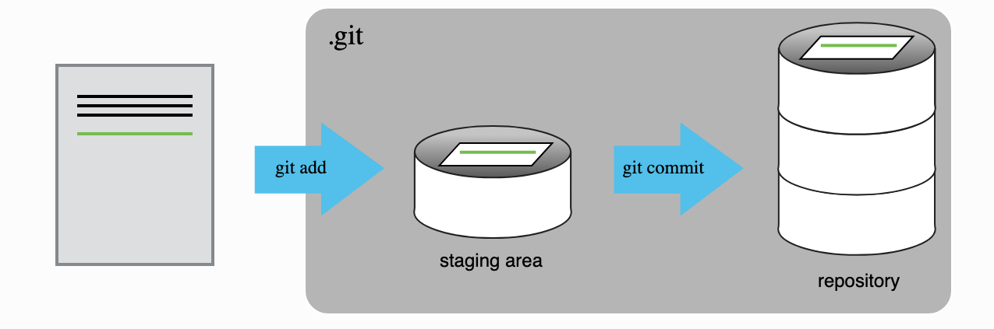
How does Git work?

Slide 11
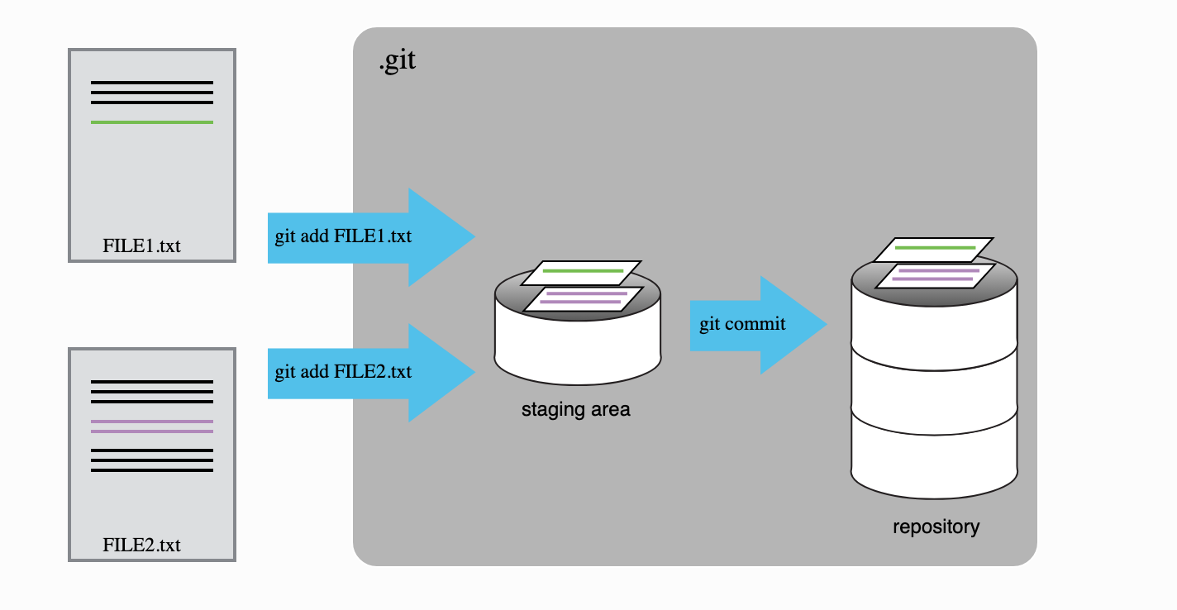
How does Git work?

Slide 12
Track changes
git status
git log (shows the time and date of each commit)
git log --patch (shows the details of the file)
git diff (helps to review changes)
git diff --staged (Press q to quit)

Slide 13
Committing a folder
mkdir temp
ls -a
git status
touch temp/.gitkeep (Create an empty file inside an empty folder)
git status
git add .
git commit -m “Added a temp folder”
git status

Slide 14
Delete Files
touch newfile.txt
ls -a
git status
rm newfile.txt
git status
Question: Will it be removed?

Slide 15
Delete Folder
rm -rf -- temp
ls -a
git status
git add .
git commit -m “removed file and folder”

Slide 16
Ignore files
mkdir config
touch config/private.txt
git status
Create a .gitignore file (config/ - specify files and folders you want to ignore)
git status
ls -a
git add .
git commit -m “Added gitignore config”
git status

Slide 17
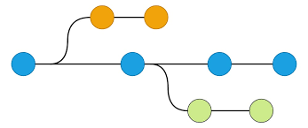
02
Git branching

Slide 18
What are branches?
In Git, a branch is a new/separate version of the main repository
Take an example of Thierry Henri, Nadia and Zida working on a group project together. Their repo will have one main version (main branch) but the different team members need to work on different parts at the same time.
Instead of modifying the same files and messing up the report, each person takes a copy (creates a branch) and works on their section separately:
Thierry works on the introduction (intro-branch)
Nadia works on the presentation (presentation-branch)
Zida worjs on the conclusion (conclusion-branch)
Once everything is done, they bring back their changes, merge them into the main project and nothing gets lost or overwritten.

Slide 19
Working with branches – creating and switching
Show the branches on your repo: git branch (it will highlight the branch you’re currently on.)
To create a branch, we use the git checkout command: git checkout –b feature/web-interface
git status
Create an index.html file. Put in boilerplate HTML code
Make a commit
Switch back to the main branch: git checkout main (or master, depending)
Can you see the index.html file there?
Switch to the feature/web-interface branch. Is the index.html file back?

Slide 20
Working with branches – merging
The goal of most branches is to work on a feature or a bug fix and once the work is done and has been tested, to merge this branch back to the main
To merge a branch into the main branch,
Switch to main branch
Make sure you’re on the main branch (run the git branch command)
Use the command: git merge feature/web-interface
List the content of the repository. Have you seen the html file now?
Switch back to the feature/web-interface branch, is it different from the main?
Once you’ve merged a branch into main (and are no longer in need of it), you can delete it using the git branch –d branch_name command.
Delete the feature/web-interface branch.
NB: there are 2 ways to delete a branch git branch –d branch_name or git branch –D branch_name. How are they different?

Slide 21
Working with branches – rebasing
Both git merge and git rebase are used to integrate changes from one branch into another.
Git rebase integrates changes by rewriting the commit history
To understand the difference between merge and rebase, do the following:
While on the main branch, create a new branch called feature, and switch to it (git checkout –b feature)
Create a file, file.txt and put the text “Feature work” in it. Make a commit
Create another file, file2.txt and put the text “Another file in my path”. Make a commit
Create one more file (I promise this is the last one) called file3.txt put the text “April Fools Day?”. Make a commit
Create one more file called file4.txt, put the text “Fooled you didn’t I 😏”. Make a commit

Slide 22
Working with branches – rebasing
At this point in time, the feature branch should have 4 commits.
Experimenting with git merge
Switch back to the main branch and merge it with the feature branch
Run the command git log --oneline –graph --all
Experimenting with git rebase
While on the main branch, we are going to do a hard reset to go back to a previous version of the code
Run git reset --hard HEAD~1 (to be explained)
Switch to the feature branch
Run the command git rebase main
Run git log --oneline --graph, compare this output to the one from git merge.

Slide 23
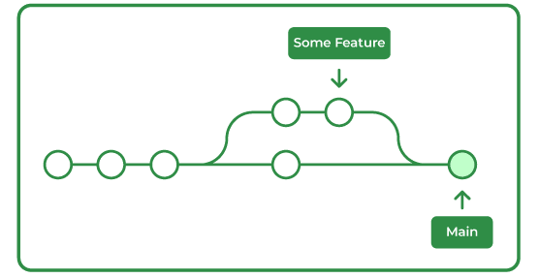
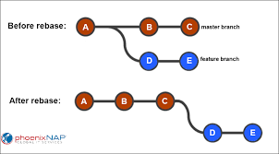
Working with branches – rebasing
Git merge
Git rebase
Preserves commit history
Creates a merge commit (in the case when it’s not a fast-forward merge)
Safer to use on shared branches
Rewrites commit history
Does not create a merge commit
Maintains chronological order
Not safe to use on shared branches

Slide 24

03
OOPS, I messed up

Slide 25

Undoing mistakes
So, you being human made a mistake like all other humans (except me, I’m a demigod) and need to undo your mistake.
In real-life, the best you can hope for is another chance but in computer science, we have a time machine known as git.
In git, there are several ways one can undo a mistake, we will cover the most common ones.

Slide 26

Undoing mistakes – git checkout
Working with commits
Working with files
Looking at (checking out) a commit: git checkout <commit-hash>
You can check out an old commit and create a new branch from there: git checkout –b new-branch. This is useful if you want to make modifications to some files in that commit.
Undoing unstaged changes: you modified a file but haven’t staged it yet and want to discard the changes: git checkout -- <file>
Recovering a deleted file that was in a previous commit: git checkout HEAD -- <file>

Slide 27
Undoing mistakes – git reset
Soft reset
Mixed reset
Hard reset
You want to undo the last commit but keep the changes: git reset –soft HEAD~1
Puts the last commit in the staging area and keeps all file modifications.
You want to discard the commit and unstage changes: git reset --mixed HEAD~1
Unstages changes, does not delete them from the working directory
Undoing a commit and discarding changes: git reset --hard HEAD~1
Deletes the last commit and discards all changes from the working dir and staging area.
NB: HEAD~1 simply refers to the commit hash of the previous commit. These commands can work using the hash of any commit.

Slide 28
Undoing mistakes – git revert and commit --amend
Git revert
Git commit --amend
Git revert is used to undo a commit without changing history: git revert <commit_hash>
It creates a new commit that undoes the changes from the specified commit.
This is the safest option to use in the case of a collaborative project with multiple collaborators.
A convenient way to modify the most recent commit: git commit --amend
Lets you combine staged changes with the previous commit instead of creating an entirely new commit.
Can also be used to simply edit the previous commit message

Slide 29
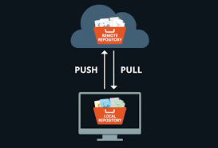


Working with remote repositories
Git vs Gitlab. Pushing, pulling, handling conflicts

Slide 30
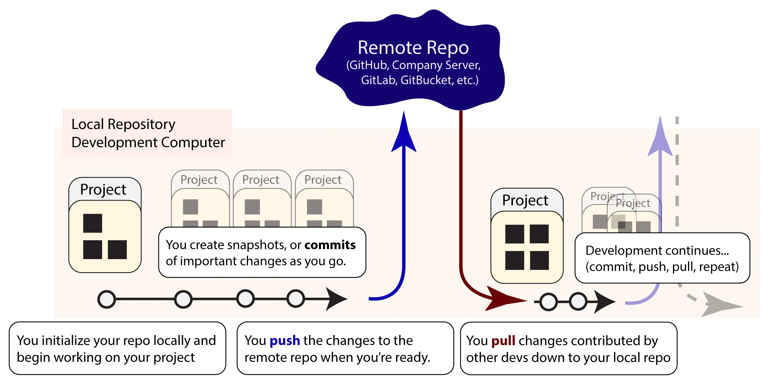

Slide 31
Git vs (GitHub & Gitlab)
Git vs (GitHub and Gitlab)
Git is a version control system that helps you track changes to your files locally (on your computer).
GitHub and GitLab are remote hosting platforms for git repositories. They add collaboration tools on top of git, such as:
A central place to store and share code (remote repositories).
Pull/Merge Requests – Where others review your changes before they’re accepted.
Issues and Project Management – A way to track work and discussions.
CI/CD Pipelines – Automated tests to ensure your code meets quality standards before being served.
Notes:
Gitlab and GitHub areknown as remote repository hosting platforms or git hosting services

Slide 32
Git vs (GitHub & Gitlab)
Analogy: Cooking at home vs a family meeting
Git is like cooking in your own kitchen.
You decide what to make, how to prepare it, and when to save your progress (commit).
If you try a new recipe but don’t like it, you can always go back to an earlier version (checkout a previous commit). Everything stays in your kitchen.
GitHub/Gitlab on the other hand are more like a family meeting
Each family (developer/team) prepares food (code) at home using their own kitchen (local git repository).
When they’re ready, they bring their dishes to the meeting
At the gathering, everyone can taste each other’s food, or even mix dishes together (collaborate on projects, submit pull/merge requests).

Slide 33

GitHub vs Gitlab
GitHub and Gitlab are both git repository hosting platforms.
They both provide a web application (hosted by them) that users can use to interact with the repositories hosted there.
Gitlab is the only one of the two that can be self-hosted. Gitlab is an application that you can download and run on your machine whereas GitHub is only available online.
GitHub is the most popular for open-source software. GitLab is preferred by enterprises that need mor control.

Slide 34
Working with remote repos
A remote repository is a version of the repo stored on a different machine or server, allowing multiple people to collaborate.
Normally, services like GitHub/GitLab provide hosting, but here, we will simulate it using another folder on the same machine.
Creating a "Remote" Repository Locally
Create a directory to act as the remote repo (in the course’s folder) mkdir git-remote cd git-remote git init --bare
The --bare flag tells Git that this repository will not contain working files (since a remote repo is usually just for storing changes).
This simulates a remote repository like GitHub or GitLab.
Notes:
Gitlab and GitHub areknown as remote repository hosting platforms or git hosting services

Slide 35
Working with remote repos
Now, we need to connect our local repo to this remote repo
cd into our gitlab repo we created earlier
run the command git remote add origin ../git-remote
origin is the alias for the remote repo (you can call it whatever)
Try running git remote -v to show the linked remotes
Our remote repo is currently empty, let’s push some code to it: git push origin main
Now we want to add some files, it is best practice to create a new branch whenever you’re working on a feature. Create a new branch called feature-branch
Make a change (create a new file and commit) echo "Hello, Git!" > file.txt git add file.txt git commit -m "Add file.txt"
Notes:
Gitlab and GitHub areknown as remote repository hosting platforms or git hosting services

Slide 36
Working with remote repos
Push the changes to the feature-branch on the remote repo: git push origin feature-branch (this creates a new branch on the remote)
You can check if it worked by doing ls ../git-remote/refs/heads/, this should show feature-branch
You can also cd into the git-remote folder and type git branch
Ok, now we want to simulate pulling from the remote. Switch to the main branch (git checkout main)
Pull changes from the remote’s feature-branch: git pull origin feature-branch (this is not the ideal way but for explanation purposes...)
This command merges the remote’s feature-branch into the local repo’s main branch
Notes:
Gitlab and GitHub areknown as remote repository hosting platforms or git hosting services

Slide 37
Working with remote repos
We will create a merge conflict and then resolve it. We will do this by modifying a file in both the main and feature-branch and trying to merge the two.
Ensure you’re on main: git checkout main
Modify file.txt and commit echo "This line is from main." >> file.txt git add file.txt git commit -m "Update file from main"
Switch to feature-branch
Modify file.txt different and commit echo "This line is from feature-branch." >> file.txt git add file.txt git commit -m "Update file from feature-branch"
Notes:
Gitlab and GitHub areknown as remote repository hosting platforms or git hosting services

Slide 38
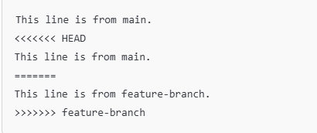
Working with remote repos
Merge branches
Switch back to main (git checkout)
Attempt to merge feature-branch: git merge feature-branch. Git will show a merge conflict
Resolve the conflict
Open file.txt and you’ll see:
Notes:
Gitlab and GitHub areknown as remote repository hosting platforms or git hosting services

Slide 39

Working with remote repos
Resolve the conflict
Edit the file manually to keep the desired lines. Let the file look like:
Mark the conflict as resolved git add file.txt git commit -m “Resolved merge conflict”
Push the resolved changes to the remote: git push origin main
Notes:
Gitlab and GitHub areknown as remote repository hosting platforms or git hosting services

Slide 40
Working with remote repos
Managing remotes
Adding remotes: git remote add remote_name remote_url e.g. git remote add origin ../git-remote
Viewing remotes: git remote -v
Renaming a remote: git remote rename old_name new_name e.g. git rename origin local_origin
Changing a remote’s url: git remote set-url remote_name new_url e.g. git remote set-url origin ../git-remote/remote-repo
Removing a remote: git remote remove origin
Notes:
Gitlab and GitHub areknown as remote repository hosting platforms or git hosting services

Slide 41
Working with remote repos
Best practices recap
Always work on branches instead of main
Pull before pushing to avoid conflicts
Write clear commit messages
Resolve conflicts carefully and commit the resolved version
Use git remote commands to manafe repo connections.
There’s still a world of git commands and functionalities out there but we have covered the most essential. The rest you shall encounter on your codeventures.
Notes:
Gitlab and GitHub areknown as remote repository hosting platforms or git hosting services

Slide 42


